Slide 1

Setting up your goal
Single number
evaluation metric
deeplearning.ai

Slide 2

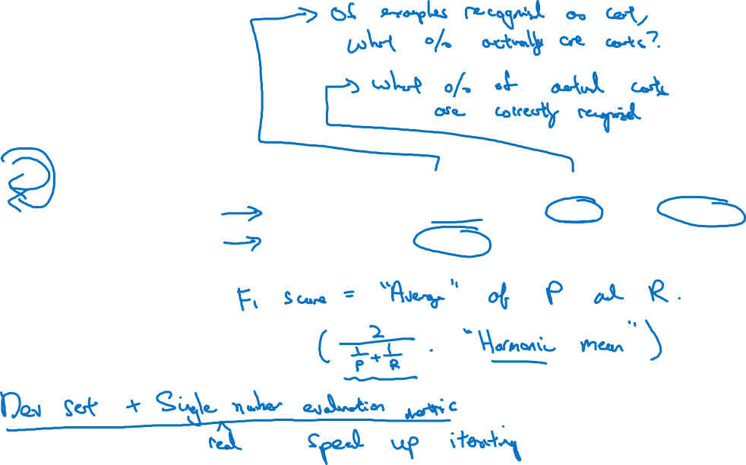
Using a single number evaluation metric
So if classifier A has 95% precision, this means that when classifier A says something is a cat, there's a 95% chance it really is a cat.
Idea
Classifier | Precision | Recall | F1 Score
A | 95% | 90% | 92.4%
B | 98% | 85% | 91.0%
Experiment
Code
So if classifier A is 90% recall, this means that of all of the images in, say,
your dev sets that really are cats, classifier A accurately pulled out 90% of them.
Harmonic mean (調和平均)

Slide 3
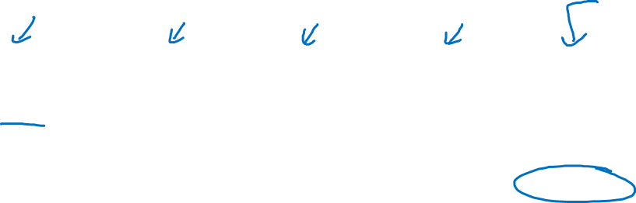
Another example
Algorithm | US | China | India | Other | Average
A | 3% | 7% | 5% | 9% | 6%
B | 5% | 6% | 5% | 10% | 6.5%
C | 2% | 3% | 4% | 5% | 3.5%
D | 5% | 8% | 7% | 2% | 5.25%
E | 4% | 5% | 2% | 4% | 3.75%
F | 7% | 11% | 8% | 12% | 9.5%

